Slide 1
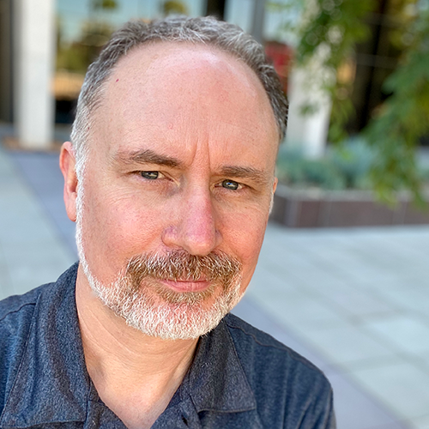
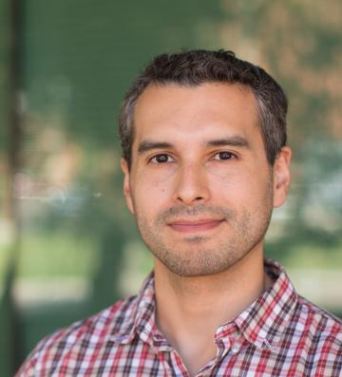
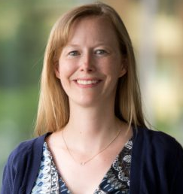



A Tri-University Approach to Strengthen Arizona
Research Data Management Services in a Post-pandemic Environment
Fernando Rios PhD, Research Data Management Specialist, University of Arizona
Matt Harp, Research Data Services and Outreach Librarian, Arizona State University
Brittany Blanchard, Research Programs Librarian, Northern Arizona University
AzLA July 2022 Webinar
Notes:
YouTube Recording: https://www.youtube.com/watch?v=SymI1SSNGLQ
Abstract
Since 2017 information professionals at Arizona State have collaborated with those at the University of Arizona (the only state university in Arizona with a medical school) and Northern Arizona University on multiple cross-disciplinary scholarly communications projects. Arising in lock-step with these efforts are data compliance, sharing, and preservation questions that we must address at the institution level. The impacts of COVID-19 on academia affected all aspects of the research ranging from the undergraduate experience to the research enterprise. Research activities centered on the virus have been a priority of funders such as the NSF and NIH, with an added global interest in sharing that research as quickly as possible. In this presentation, attendees will gain an inside view of how the libraries at the three universities collaboratively tackled research data management issues highlighted by the pandemic, including an increased need to provide data sharing services and the lack of a tri-university research data policy.
Presenters:
Fernando Rios, Research Data Management Specialist, University of Arizona. Rios provides data management and data curation consulting for researchers, staff and students at the University of Arizona. He assists in developing plans for effective data management, sharing, and publishing, providing best practices for writing shareable and reusable software; and increasing efficiency and impact via tools and workflows for reproducible research. Rios has a background in geography and scientific computing, and his current interests include research reproducibility and research software preservation with the goal of improving research transparency, accessibility, and stewardship. Rios has a PhD in Geography from the University of Buffalo.
Brittany Blanchard, Research Programs Librarian, Northern Arizona University. Brittany oversees NAU’s institutional repository OpenKnowledge@NAU. She works with researchers on constructing effective data management plans for grants and helps find suitable repositories for data that aligns with funder requirements. Her research interests are centered around all things Open, including science, access & educational resources.
Matthew Harp, Research Data Services and Outreach Librarian, Arizona State University. His research interests include scalable, open research infrastructure and responsible stewardship of research outputs. He provides consultations and workshops on research data management and sharing and manages ASU’s Dataverse Research Data Repository publication requests. Matthew also worked as a Digital Library Projects Manager and shared strategies for library podcasting and outreach efforts.

Slide 2
Introduction & Overview
Research data management services at the three institutions
The Tri-U RDM collaboration
  Organization
  Tri-U Research Data Policy
  Data repository collaboration
Challenges and opportunities
Notes:
FR
Start by talking about what RDM is and what it looks like at our 3 inst.
Move to an overview: how we started / are organized. Also highlight 2 major collaborations
Wrap up: challenges/opportunities

Slide 3
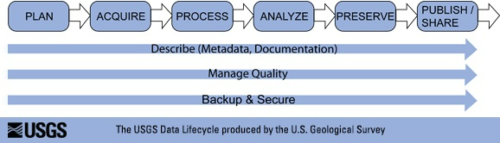
What are Research Data Management Services?
Research data = data used in (or produced by) academic research
  Data that are used as primary sources to support technical or scientific enquiry, research, scholarship, or artistic activity, and that are used as evidence in the research process and/or are commonly accepted in the research community as necessary to validate research findings and results (CASRAI RDM glossary)
Research data management
  processes undertaken to create organized, documented, accessible, and reusable quality research data (ALA Keeping up with RDM, Corti et al., 2014)
Research data management services
Why?
Massive amounts of info that needs processing
Data sharing mandates
FAIR
Greater research impact, reproducibility
Data collection protocols, pipelines organization, machine readability
Notes:
FR
Data collection protocols, organization, machine readability

Slide 4
Poll
Did you know academic libraries often offer research data services?
Notes:
FR

Slide 5

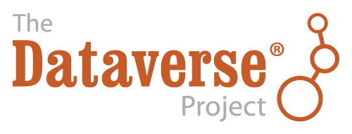
Why are the libraries involved in this?
Information management is at the core of libraries
  Organization practices
  Long-term stewardship
  Finding stuff
Advocates for open access
  RDM helps with open data sharing
Scholarly communications
  Research data is a scholarly output
RDM support involves many stakeholders
  Library as a connector
Notes:
FR
Info mgmt: information organization practices, long-term stewardship, helping people find stuff
Open access: a big reason RDM is important is it helps enable effective data sharing
Schol comm expertise: Helping others navigate licensing, copyright, metadata, etc prepping for publication
Connector: we can’t be experts in everything. Help connect ppl to the right resources.

Slide 6
The UA/ASU/NAU Data Services Collaboration Group
Notes:
FR
Each distinct institutions and backgrounds but all ABOR (Arizona Board of Regents) institutions
Our collaboration

Slide 7
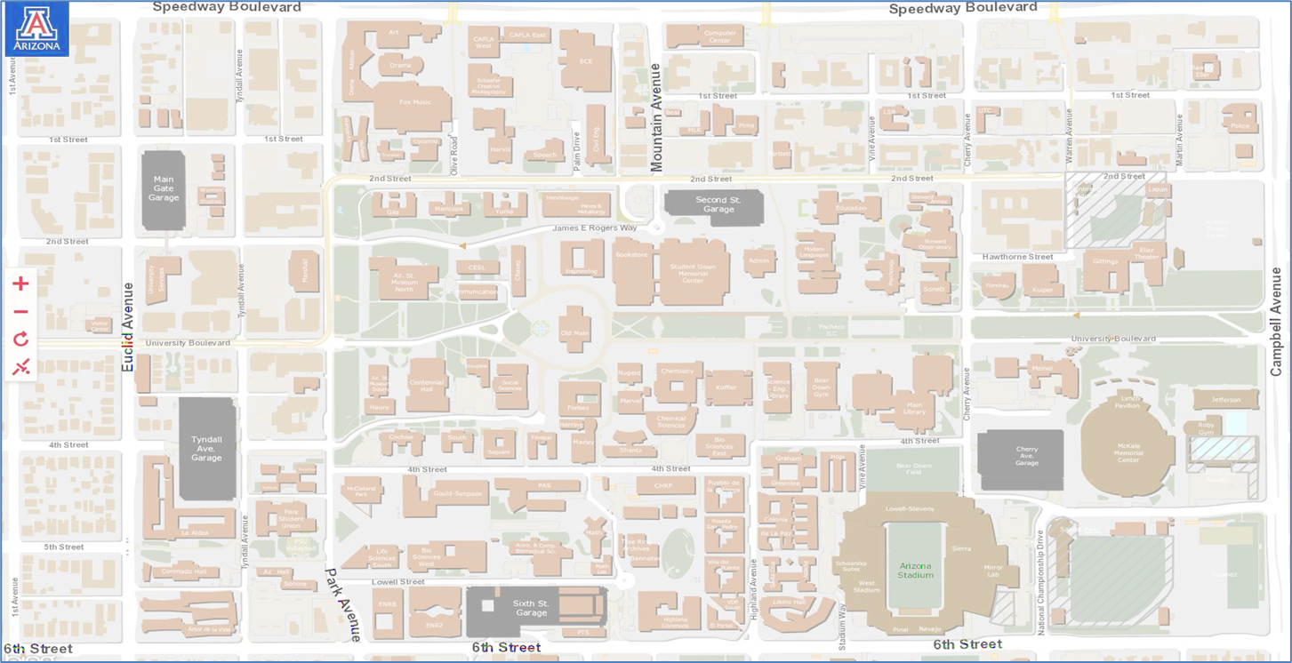
RDMS: University of Arizona Context
FY21: $761M R&D Expenditures, top 3 sponsors: NIH, NASA, NSF
2015-2017
2011-2012
DMDC Pilot
Public access wrk. grp
RDM specialist hire
2018-2020
Data curation librarian position created
DMPTool support
Open Science Framework
ReDATA
2013-2014
2013
Campus DM committee appointed
Campus RDM survey
2021-2022+
Whitehouse OSTP Memo - public access mandate
Indigenous data sovereignty
Tri-U policy
NIH DMSP policy
Research office (RII), Research Computing (UITS), Data Science Institute, IRB, NPTAO
Notes:
FR
Throughout: work closely with with the research office, called Research, Innovation & Impact (RII) and the Research Computing arm of central IT.
NIH DMSP: (UA has only public med med sch in AZ)

Slide 8

RDMS: Arizona State ContextState University Context
2011 ASU Digital Repository released
2018 APLU Accelerating Public Access to Research Data memo Library and Knowledge Enterprise formalize Partnership
2020 Repositories split up IR + Data + Dig Library Research Data Librarian
2022 Michael Crows HELIOS co-chair Division for Open Science and Scholarly Communication
2013 - 2017 AZ LiveData Project ASU OA Policy
4,700 + faculty and 135,729 fall 2021
$677.3M in research expenditures in FY 2020
asu.edu/about/facts-and-figures
Notes:
Matt
The ASU Library released its first digital repository in 2011. It was a home grown system and not optimized for sharing research data.
Over the next few years we collaborated on a number of projects, including the tri-university, Arizona Board of Regent’s LiveData project and ASU adopted an Open Access policy for research publications. This policy did not include research data however.
Then in 2018 the Library partnered with ASU’s new Research Data Management Office. We focused on workshops about reproducibility and open science, and developed opportunities for liaison librarians to gain research data services skills.
By October 2020, the library moved to new repository platforms, breaking up the legacy repository for two Islandora Open-Source Digital Asset Management systems for scholarly works and digital library collections. We also deployed a dedicated research data repository powered by Harvard’s Dataverse platform.
A research data management librarian position was also funded and we shifted from providing workshops to focus data repository services.
Today ASU’s President Michael Crow, a co-chairs of the Higher Education Leadership Initiative (HELIOS), actively communicates on publicly accessible research that in his words will ‘advance a massively open and transparent research ecosystem.’ Serendipitous to this theme the ASU Library created the unit for Open Science and Scholarly Communication bringing research data management and sharing into the fold of scholarly publishing, expanding our educational programing, and connecting to the library’s strategic priority to expand interdisciplinary research, discovery, and development by 2025.

Slide 9
Northern Arizona University
1,000+ Faculty
As part of AZ LiveData NAU develops IR
One institutional repository to serve all the needs
Library helps with DMP & the DMPTool
Creates guides & workshops to assist researchers with meeting funder requirements
Informal working relationships with library, ITS & Office of Research
Notes:
BB-
NAU has a smaller research footprint. Currently our IR which is billed as the “data repository of last resort” has worked okay for our researchers though there have been some data sets that were either too large or had specific requirements (like a DOI) that we couldn’t accommodate. I largely work with our researchers to try to find other possible repositories for their data

Slide 10
Why should you care?
Data Librarians are advocates for research transparency and getting data out there
Through RDMS, we help move forward ethical data practices. E.g., CARE principles
The work isn’t always visible outside the institution
  Data policy, researcher support
Outside
  Creation of resources
  Ability to use data/archives for teaching
  Influence on the policies of federal funders for data sharing
Know that libraries with RDMS often provide data resources useful to the public
  Datasets, guides for data management best practices,
Notes:
BB
Libraries are a part of providing trusted information - it’s in our collective DNA to help navigate information resources which is now more important than ever.
Libraries seen as a place for promoting inclusive activities
(e.g, Borderlands newspaper)
Collective Benefit, Authority to Control, Responsibiity, Ethic

Slide 11
How our collaboration got started
2017 - 2018
2019
2020 - now
Informal conversations ‘17
Fall ‘18 AAU/APLU workshop: accelerating public access to research data
Upper level research admins, 30+ institutions
Strategies for public access
Debrief: Clear areas of collab
Group coalesced
Librarians
Data specialists
IT specialists
ASU RD officer
Monthly meetings
Initial issues
Costs / sustainability of RDM services
Information exchange
Info sharing
Dealing with the pandemic
updates
Focused work
Intense effort on a Tri-U RD policy
Data repository rollout
Notes:
BB
A late 2018 workshop sponsored by the Association of Public Land-grant Universities (APLU) and the Association of American Universities( AAU) on accelerating public access to research data
Attended by upper-level administrators from UA and ASU
Identified collaboration on issues of shared concern
Costs of data storage and data curation
In 2019, an informal group of interested individuals coalesced.
Mostly library, some from research computing. ASU’s Research Data Officer.

Slide 12
Organization
Approach: Support network
No hierarchy, grassroots
Core group is important because of turnover
Pandemic
Collab was already remote
Framework in place to quickly
address issues
  Collaborated on dataset resources for COVID research
Lib. IT / devs
Schol. Comm
Core group: ~3-4 RD Librarians
Digi Pres.
Research office
Notes:
BB

Slide 13
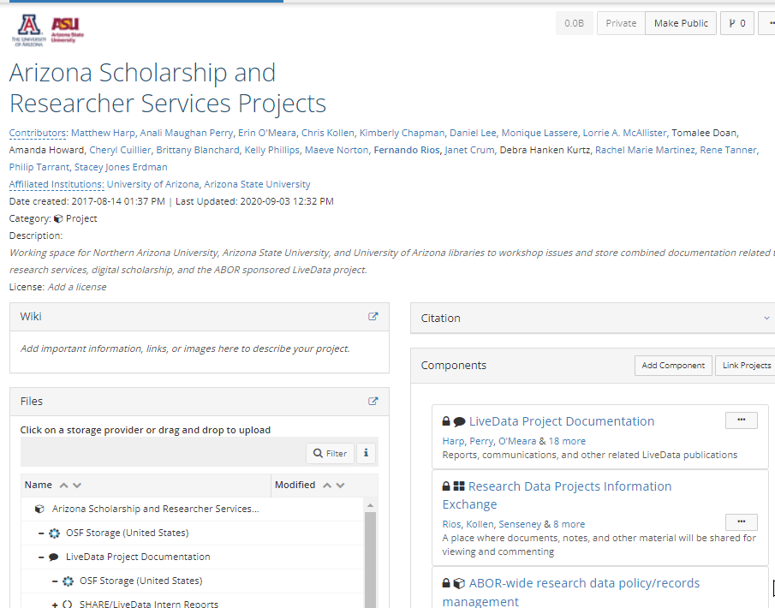
Collaboration tools
Google Drive
Running notes
Drafts, other materials
Jamboard
OSF
High-level group organization
Slack, When2Meet
Notes:
BB
[chat: ask people to add their favorite collab tools in the chat]
We as a group settled on these tools.

Slide 14
Collaborations
2019-present:
Sustainability models for library-based data services
The changing landscape of funder data policies
Connecting with campus stakeholders at our respective institutions
Contributed to an ASU-led effort to quickly compile a page on COVID-19 data and resources
Develop a proposal and draft for a tri-university research data policy
Data repository services rollout by UA and ASU
Notes:
BB
Exploring sustainability models for library-based data services (core facilities)
Sharing information and discussing the implications of the changing landscape of funder data policies
Sharing challenges as UA, ASU rolled out data repository services
Discuss approaches and outcomes for connecting with campus data stakeholders at our respective institutions
Research computing, research office, etc.
Explore tangible collaborations on sharing data infrastructure (ASU, NAU)

Slide 15
Outcomes: Tri-U Research Data Policy
Notes:
MH
One of the outcomes of our conversations and collaboration is the development of proposal for shared research data management and sharing policy.

Slide 16

Collaborative Strategy
Grassroots approach
shared awareness of needs
Propose a low-weight request
Notes:
MH
The policy development work is a grassroots approach.
No one asked us to do this. We formed from a shared awareness that our universities have policies for our patron, business, and administrative data but lack a robust policy for research data.
Despite our differences, we would make a stronger argument for administrative support together rather than taking individual approaches.
We believe it is essential for organizations to support these types of conversations but recognize there are limits. We needed a low-weight approach to get their attention, and a shared or standard policy would require a minimum amount of administrative effort compared to requesting funds for a large project.

Slide 17

Collaborative Strategy
Collaborative proposal Writing
Sticky note exercise
Shared readings
Distributed assessment
Challenges in communicating it to people outside the group
Difficult to talk about how it’s been received outside of the group and bring it back to something actionable.
Dealing with the bureaucracy
Notes:
MH
We wrote the proposal in a collaborative way
We utilized shared readings, including journal articles and institutional policies available on the web
We held a sticky note exercise that helped us prioritize policy elements
Distributed our assessment work.
We made our goals attainable and realistic since this was not necessarily a priority project for each of us.
We faced challenges in communicating it to people outside the group since it was difficult to talk about how the work had been received and where conversations were going at an administrative level.
We also navigated the unique bureaucratic structure of each institution. We cannot control what happens outside our group, as the proposal is shared up various hierarchical chains.

Slide 18
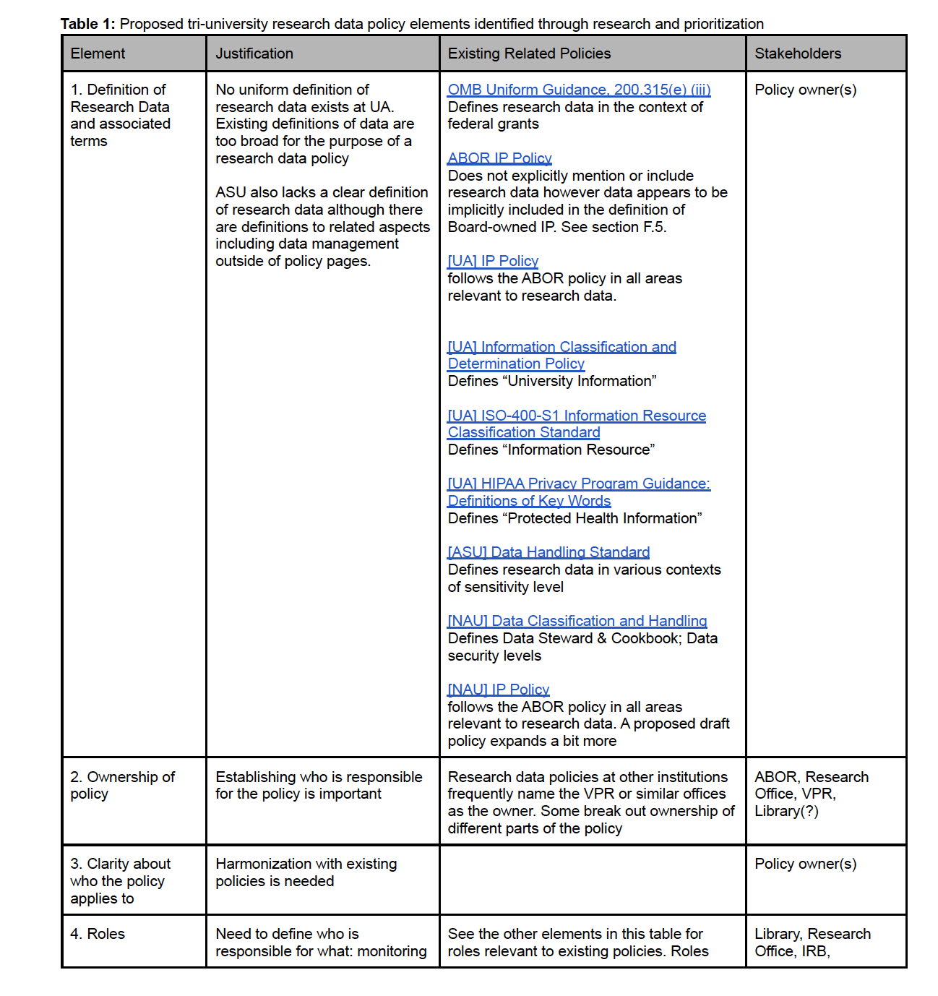
Policy elements, justifications, implementations, and stakeholders
Institutional Assignments
Rachel: Boston U, Northwestern, Columbia, Ohio State
Matt: Columbia, Ohio State, Cornell, U Minnesota
Philip: Cornell, U Minnesota, CU Boulder, Utah State
Brittany: Iowa State, Northwestern, Boston U, Utah State
Fernando: CU Boulder, Utah State, Iowa State, Cornell
Recommended Reading
“Do You Have an Institutional Data Policy? A Review of the Current Landscape of Library Data Services and Institutional Data Policies”
Briney, K. & Goben, A. & Zilinski, L., (2015) Journal of Librarianship and Scholarly Communication 3(2), p.eP1232. doi: https://doi.org/10.7710/2162-3309.1232
Notes:
MH
The team split up and assigned ourselves to reading existing policies at our own and other institutions. We also designated elements of a data policy framework to evaluate those policies.
The table on this slide represents the first four elements of that structure including definitions and associated terms, ownership of policies (who’s responsible for maintaining and enforcing them), who the policy applies to, and the roles within a policy.
Each element also includes a justification, web links or descriptions, and potential stakeholders.
After filling in our sections we compared notes and edited as a group.

Slide 19
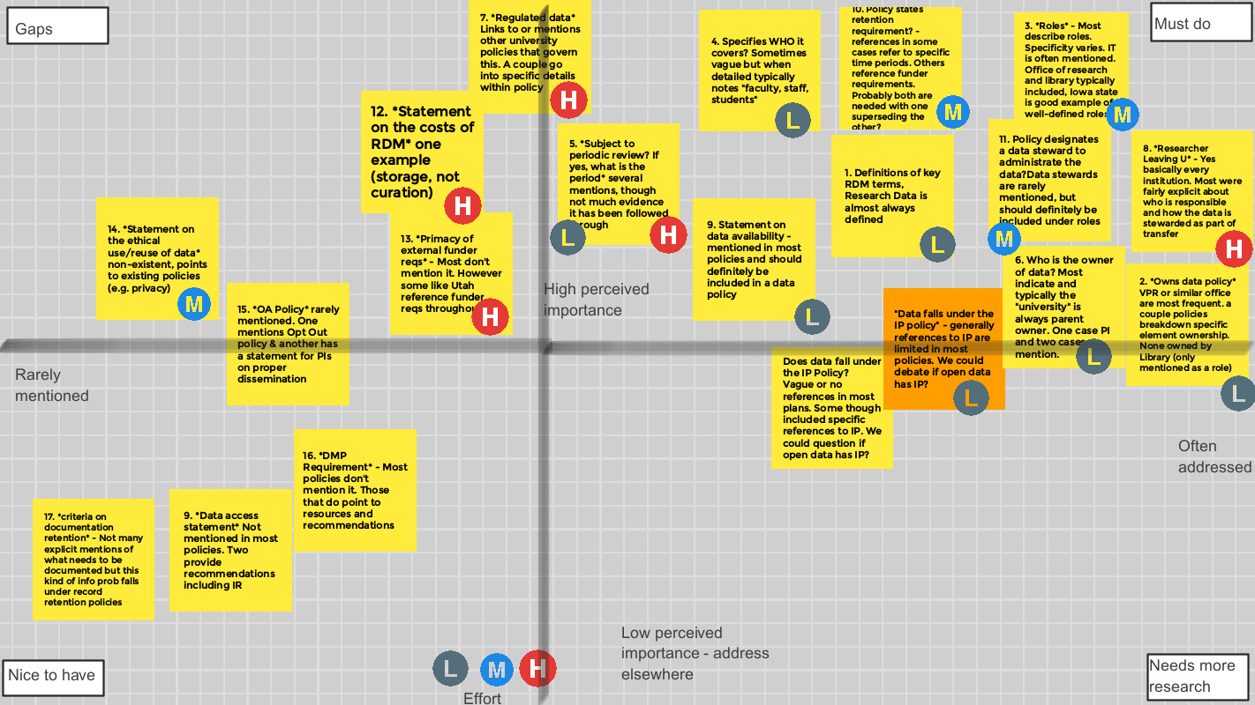
Research Data Policy Prioritization Jamboard 2021-01-08
Notes:
MH
Then in January of 2021 all three university libraries and ASU’s Research Data Management office met for an active sticky note workshop to visually prioritize existing research data policies.
We could see what was important to other institutions and connect to our own areas of focus.
The highest priority elements were moved to the top right corner as ‘Must Do’ items. Top elements included institutional roles, data stewardship designations, policy ownership, responsibilities if an author leaves an institution, and definition of terms.
Jamboard link: https://jamboard.google.com/d/1o_VZgRHZAZz8gx_PTsG-fa9YQ4hlBFGCX3ZInxkqP60/edit?usp=sharing

Slide 20
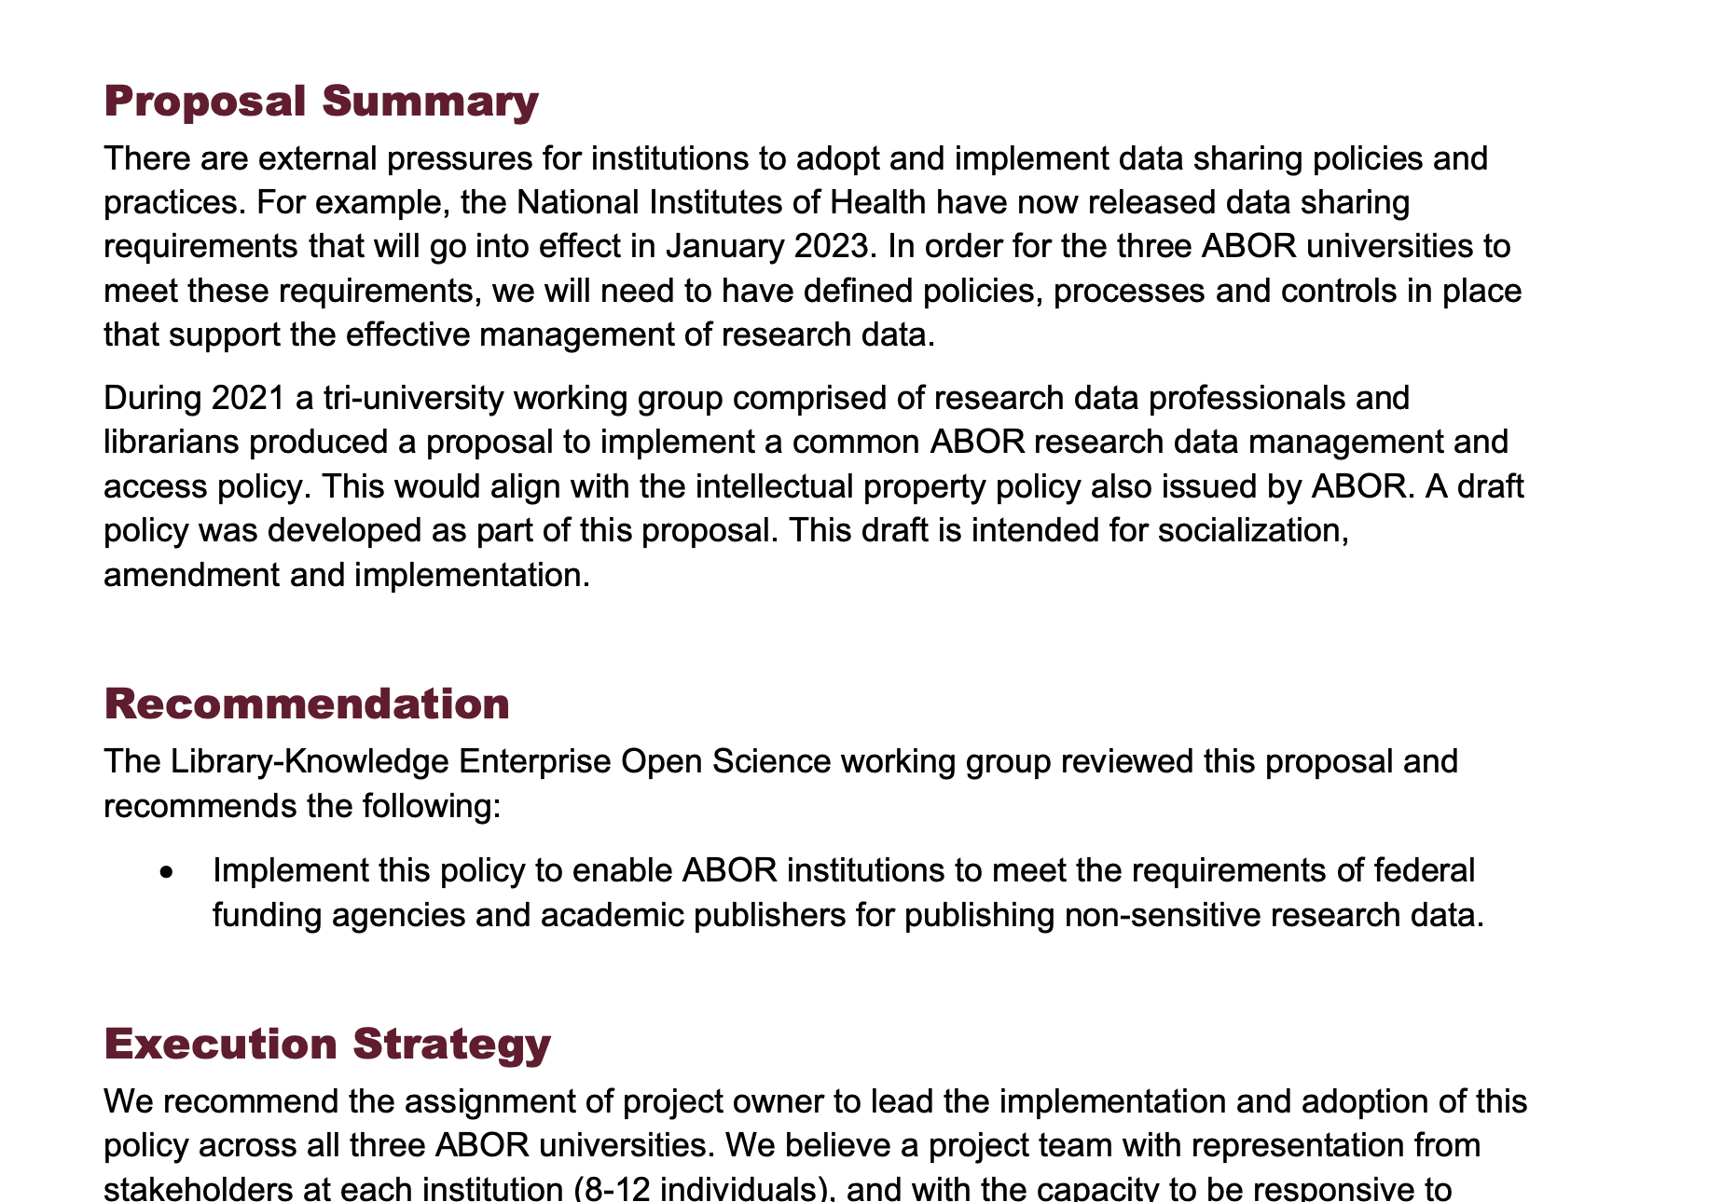
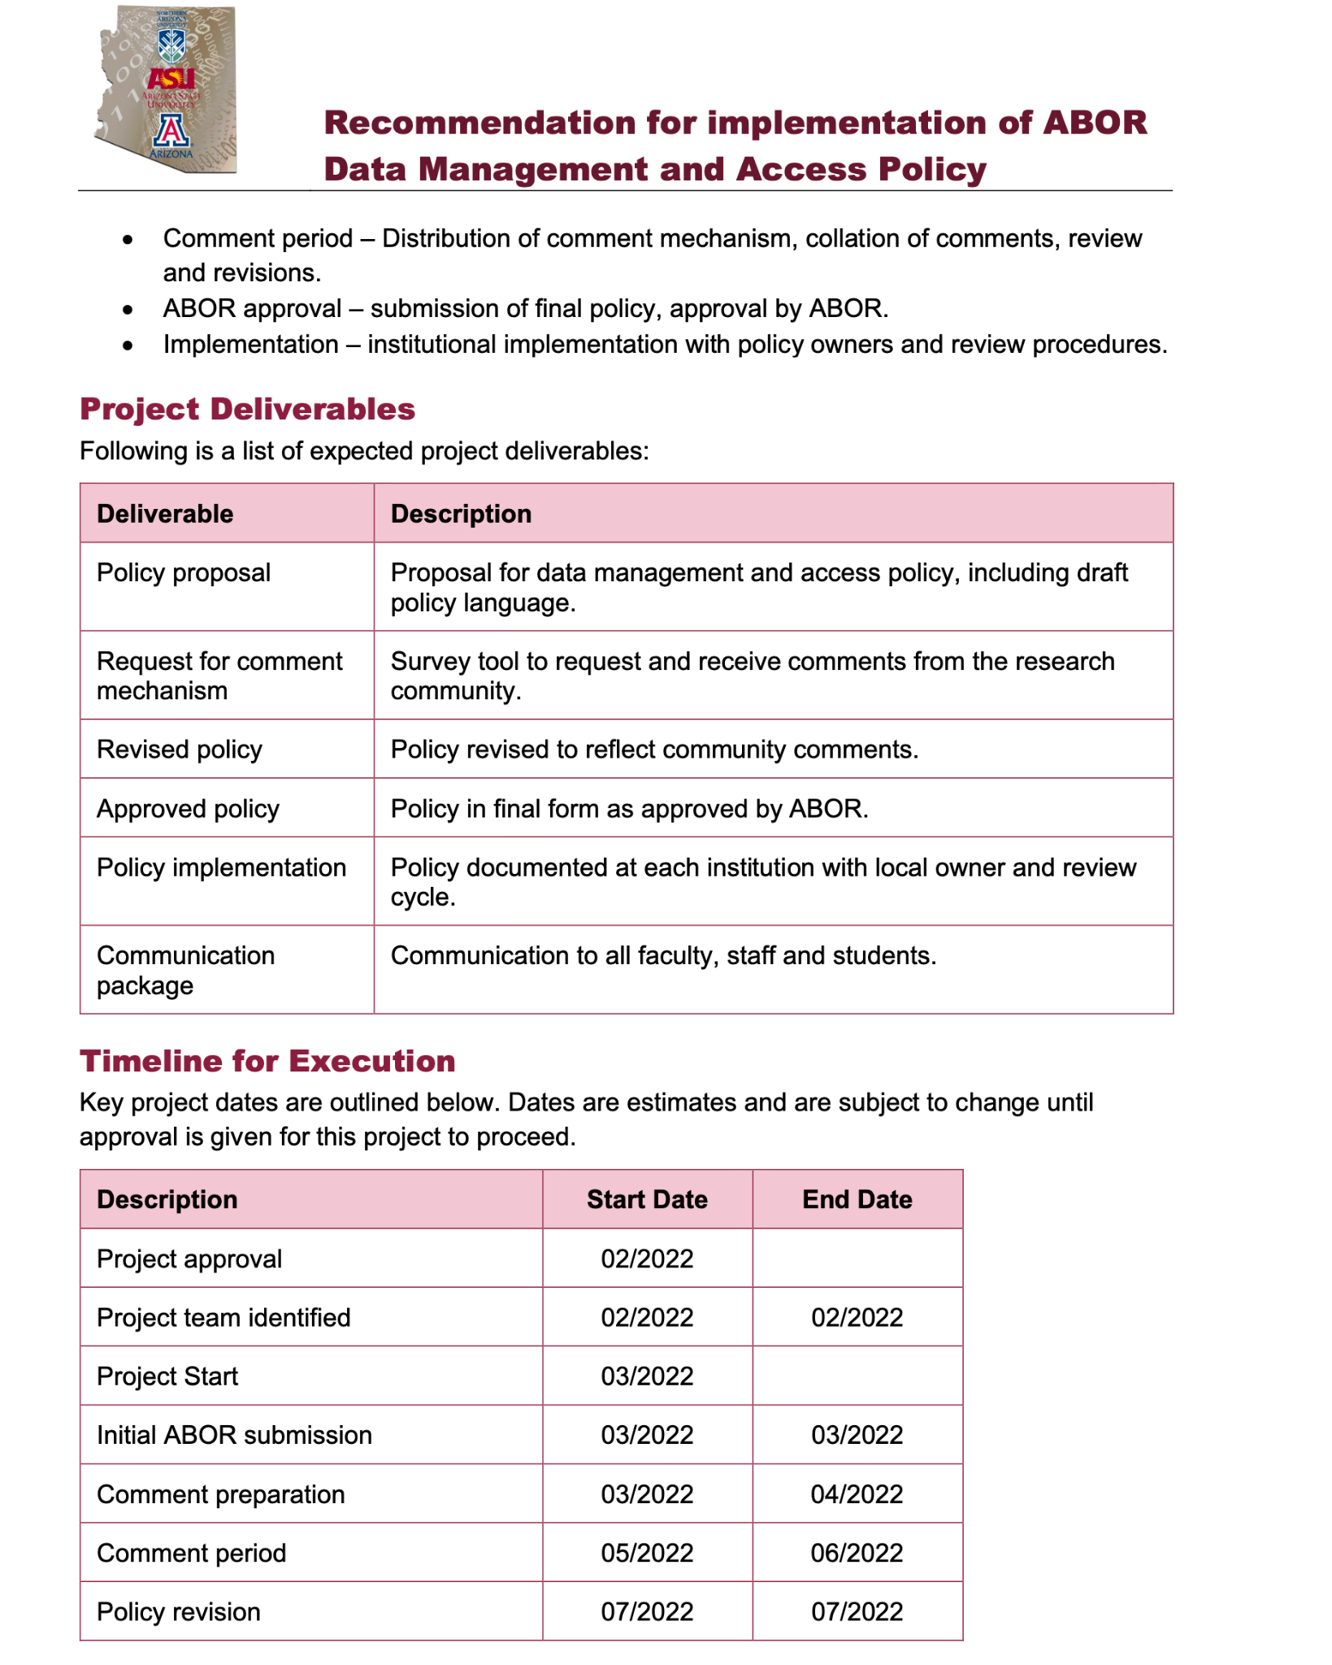
Proposal for Tri-University Research Data Policy
First draft October 2021
Second draft February 2022
Notes:
MH
Ultimately the group editing resulted in an initial draft policy proposal by October 2021. We did not draft a policy but a proposal with example text for what the policy could look like, and it circulated up and down our respective institutions.
In February 2022, Phil Tarrant from ASU’s Office of Research Data Management redrafted elements of the proposal in a framework utilized by other Arizona Board of Regents projects which is currently being considered by senior leadership.

Slide 21

Benefits for a collaborative approach
Strength in numbers
Recognizing trends
Using a proven request model
Manage expectations
Awareness of universal issues
Notes:
MH
There are many benefits to the strategy we have taken so far:
Asking for support together is more powerful than individually
We are demonstrating a consistent challenge with national evidence
We are using a proven request model that brings credibility and clarity to our work
From the beginning we have managed our expectations. Even if we don’t get everything we want, this work presents an opportunity to problem solve and share information
Libraries are asked to do a lot with little resources, and this request addresses a support need for under-funded mandates even if it’s not asking for direct resources

Slide 22
Outcomes: Data Repository Infrastructure
Notes:
FR

Slide 23
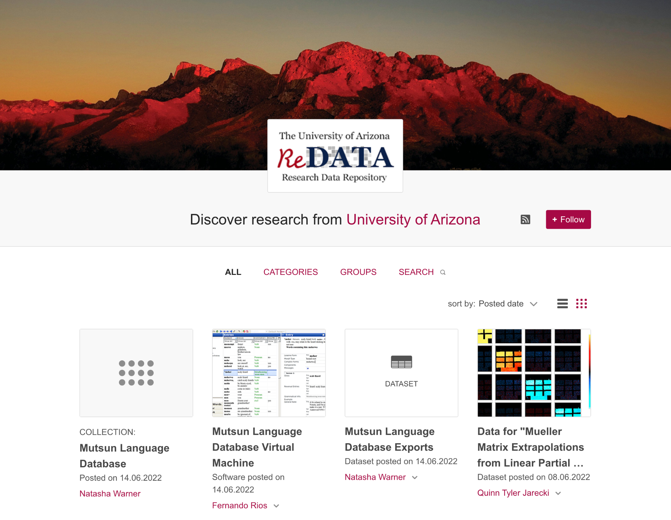
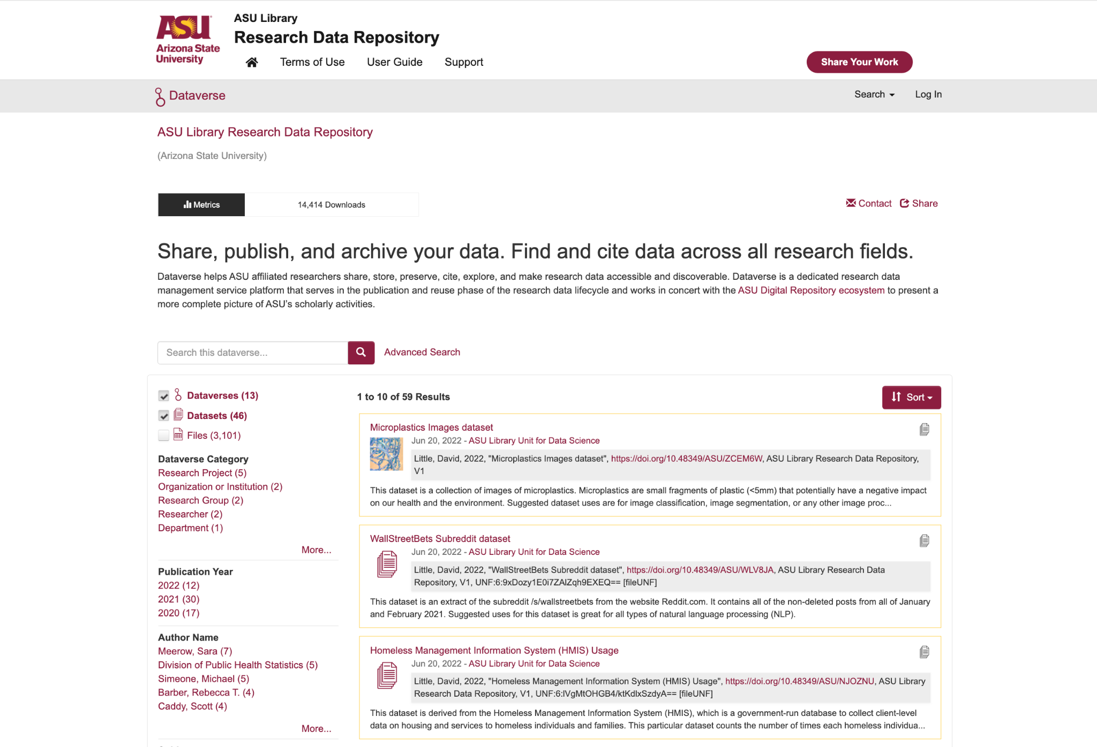
What is a data repository?
dataverse.asu.edu
arizona.figshare.com
Notes:
FR
It helps to know what a research data repository is to understand why this collaborational goals are important.
are sharing platforms for research outputs beyond the papers and presentations.
These data repositories are open access resources but may also contain restricted content with process for provisioning access. Some repositories provide both data and traditional scholarly works while other only focus on the complexities sharing research data.
They are institutionally focused and interdisciplinary which in cure many challenges not just for the library professionals who manage and curate the data but for the researchers who are submitting data to them.

Slide 24
Poll
Our collaboration seeks greater and more consistent publication of publicly funded research data and scholarship.
Do you direct patrons to institutional repositories for data or other scholarly works?
Notes:
FR
Our work with data repositories seeks to increase the availability of publicly funded research data and scholarship.
With that in mind…

Slide 25
UA/ASU lock step work
UA perspective
Focus on sustainability from the start
Capacity for technical development lower vs capacity for data curation
Built service on top of a commercial platform (Figshare)
Additional open-source code on top
After a pilot phase,
  Assessment revealed value
  secured ongoing financial support from research office - partnership
ASU perspective
Issues of matching resources to scale of university
Historic focus on technology development vs curation skills
Legacy single repository disbanded for community based platforms (Dataverse, Islandora)
Pivoting to support indigenous data sovereignty
Why not a shared infrastructure?
Notes:
FR - MH
There are a lot of similarities. Why not a tri-u shared infrastructure?
It’s always a tricky proposition. The main reason: different administrative processes and resources meant that doing something separately made more sense. We went for the approach that it’s better to have something now to build on, rather than spend 5 years trying to launch (and then maintain) a service that ends up in a system nobody is happy with and gets abandoned.

Slide 26
Exploring possible collaborations
NAU has no separate data repository but has been using their institutional repository as a “last resort”
The IR has worked so far but does not meet FAIR standards for data
Not a robust need for data set sharing. Likely will grow.
Could NAU & ASU work together on an instance of Dataverse that ASU has already implemented?
Notes:
BB

Slide 27
Challenges & Future Work
Notes:
BB Our grass roots group has made progress and kept our conversation alive, but we have lots of work to do with ever changing challenges.

Slide 28
Challenges
Changes at individual universities
Internal motivations and energy
Visibility and recognition of work
Timing/forward momentum out-of-sync
Expanding the scope
Inclusive conversations that are internal and external to the libraries
Finding times to meet
Notes:
BB & MH

Slide 29

Where are we going
Continue to influence each other and set examples for what is possible
Our policies and processes are still a work in progress
Looking ahead
In-person meetings?
More formal approach?
CC0 1.0 https://flic.kr/p/57igrk
Notes:
MH
Everything we shared today is part of an ongoing conversation and a work in progress. Even if one university is at a different stage in service or policy development we demonstrate and set examples for each other. Being able to point to others’ successes can be a motivation factor for any organization. You should also be willing to let go of the things you cannot control.
As we move forward we will continue to adapt. We may change our schedule, add new members, and start new conversations. We hope to resume in person meeting when possible or perhaps join up at library conferences like AzLA.
If our policy proposal gets a green light we may also need to adapt or form more formal and strategic partnerships because there will be expectations for us to follow through on data management and sharing policies and workflows.

Slide 30
Summary
UArizona, ASU, and NAU have been collaborating on RDM issues
Coordinated efforts have helped each institution address these issues
Collaboration structure proved useful during pandemic lockdowns
Impacts
  Expertise sharing
  Strengthened connections
  UArizona’s ReDATA and ASU’s Data Repository and a Tri-U data policy proposal
Takeaways
  Availability of public data for teaching and research
  Window into RDM at Arizona’s universities
Notes:
MH
Three Arizona public universities have collaborated on research data management and other issues since 2017
We are addressing challenges together better than we could have on our own
Our existing Zoom base setup proved useful during lockdowns, and continues to do so given our distributed locations
We have fun regular check-ins and include collaborators from our respective offices for research.
We’re all part of similar ecosystems and our repository and researcher support services have benefited for our knowledge sharing.
We hope you come away with a better understanding of what data management and sharing means in libraries and seen a window into our related activities by our three universities.

Slide 31
Thank you! You can find us at:
ASU Research Data Repository Dataverse.asu.edu
lib.asu.edu/research
mharp@asu.edu
https://data.library.arizona.edu/data-management
https://arizona.figshare.com (ReDATA)
frios@arizona.edu
OpenKnowledge.nau.edu
brittany.blanchard@nau.edu
Notes:
MH
Thank you for attending

